Slide 1
STAMM
INTERNATIONAL
INC
2024 SUSTAINABILITY
HIGHLIGHTS

Slide 2
SUSTAINABILITY ON RESOURCES REPORT
AMONG THE RESOURCES MONITORED WITH THE CONSUMMABLE OFFICE SUPPLY AND MATERIALS SUCH AS:
BOND PAPERS, PAPER TOWELS AND TISSUE ROLLS, AND PRINTER INKS.

Slide 3
TISSUE
Tissue consumption
YEAR
2024
2023
DIFFERENCE
TOWEL
929
1,121
192
ROLL
397
480
83
Total saving on Paper Towel : 192 packs
Total saving on Tissue Paper: 83 rolls

Slide 4
Cost Savings
TISSUE
YEAR
2024
2023
Total Saving
TOWEL
929 @ 45.00
1,121 @ 45.00
AMOUNT
41,805.00
50,445.00
8,640.00
ROLL
397@15.83
480@15.83
AMOUNT
6,284.51
7,598.40
1,313.89
Price
Towel @ 45Php per pack
Roll @190Php per 12Roll/15.8333 per roll
Total Savings: PHP 9,953.89

Slide 5
PRINTER INK
Ink used 2024 VS 2023
YEAR | CARTRIDGE | CARTRIDGE | INJECTABLE | INJECTABLE
YEAR | COLORED | BLACK | COLORED | BLACK
2024 | 0 | 5 | 15 | 27
2023 | 55 | 75 | 7 | 12
DIFFERENCE | 55 | 70 | -4 | -8

Slide 6
PRINTER INK
Total savings Php 49,046.00

Slide 7
BOND PAPER
Bond Paper used 2024 VS 2023
YEAR | SHORT | A4 | LONG
2024 | 452 | 147 | 93
2023 | 550 | 230 | 105
DIFFERENCE | 98 | 83 | 12

Slide 8
BOND PAPER
COST SAVINGS
Price
Short @ 165Php per ream
A4 @ 175Php per ream
Legal @ 195Php per ream
Savings for Short Php 16,170.00
Savings for A4 Php 14,525.00
Savings for Long Php 2,340.00

Slide 9
ACTION TAKEN IN THE REDUCTION OF CONSUMPTION
Back to back printing of documents
Mindful use of office supplies and materials
Documents printed only when necessary
Transition to more economical and environment friendly supplies and equipment (printer ink, Forklift, solar lightings)

Slide 10
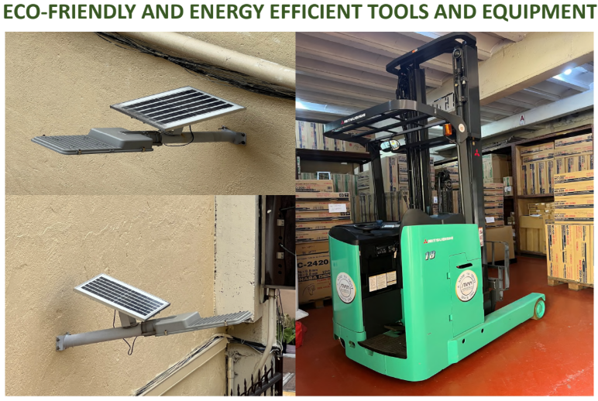

Slide 11
OTHER ACTIVITIES
Trash to Cash Initiatives. Selling of scrap papers, unusable aircon and printer. Cash generated from selling of scrap amounted to 7,000.00 in 2024.
Office general cleaning which is done every quarter.
Continuous evaluation of proper garbage segration.

Slide 12
Stamm
International
Inc.
SUSTAINABILITY
WELL- BEING REPORT

Slide 13
WELL-BEING
the company’s approach to maintain a healthy, motivated, and supported workforce as part of its sustainable development

Slide 14
2024 WELL- BEING
INITIATIVES AND PROJECTS
STEP-UP CHALLENGE
CARE AT WORK PROJECT
TEAM BUILDING
aims to emphasize t.he importance of exercise to employees, fostering a habit of endurance and promoting a healthy lifestyle
aims to bring convenience and prioritizing health while accommodating busy schedules of employees.
aims to promote camaraderie, communication and team work.

Slide 15
STEP-UP CHALLENGE WINNERS:
1ST QUARTER WINNERS
Aaron Fernandez
Judith Lagatic
1,779,482 Steps
860,317 Steps
Evelyn Velasco
1,475,694 Steps
Jose Orillaneda Jr.
Marlene Deocareza
616,091 Steps
1,581,216 Steps
Marylo Makinano
1,175,411 Steps
Semeona Generoso
523,700 Steps
Maritoni Pastoral
Melinda Sampiano
1,572,927 Steps
1,076,390 Steps
Hannah Cuaco
517,095 Steps

Slide 16
2ND QUARTER WINNERS
1st
2nd
3rd
4th
Marlene Deocareza
Nido Dequino
Maritoni Pastoral
Judith Lagatic
2,042,915 Steps
1,987,208 Steps
1,219,212 Steps
838,653 Steps

Slide 17
3RD QUARTER MILLIONAIRES
Jose Orillaneda Jr.
Maritoni Pastoral
1,963,659 Steps
1,055,967 Steps
Doris Torres
1,072,113 Steps
Nido Dequino
Rebecca Pimentel
1,495,411 Steps
1,023,570 Steps
Judith Lagatic
1,060,376 Steps
Melinda Sampiano
Marlene Deocareza
1,330,546 Steps
1,000,388 Steps

Slide 18
4TH QUARTER MILLIONAIRES
Aaron Fernandez
Nido Dequino
Jose Orillaneda Jr.
2,668,244 Steps
1,606,834 Steps
1,330,932 Steps
Maritoni Pastoral
Judith Lagatic
1,165,911 Steps
1,102,182 Steps
Doris Torres
Rebecca Pimentel
1,128,795 Steps
1,011,364 Steps

Slide 19
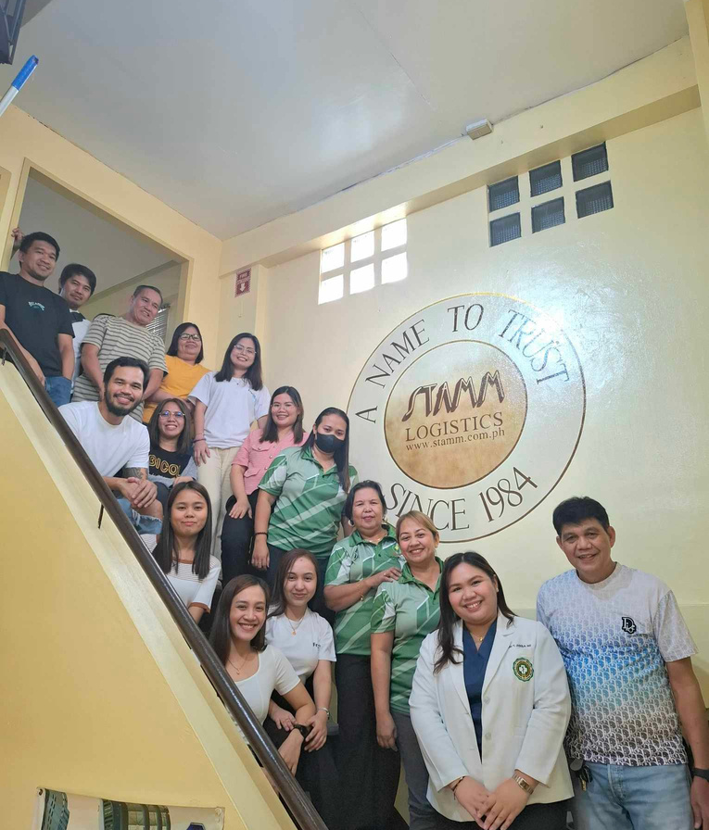
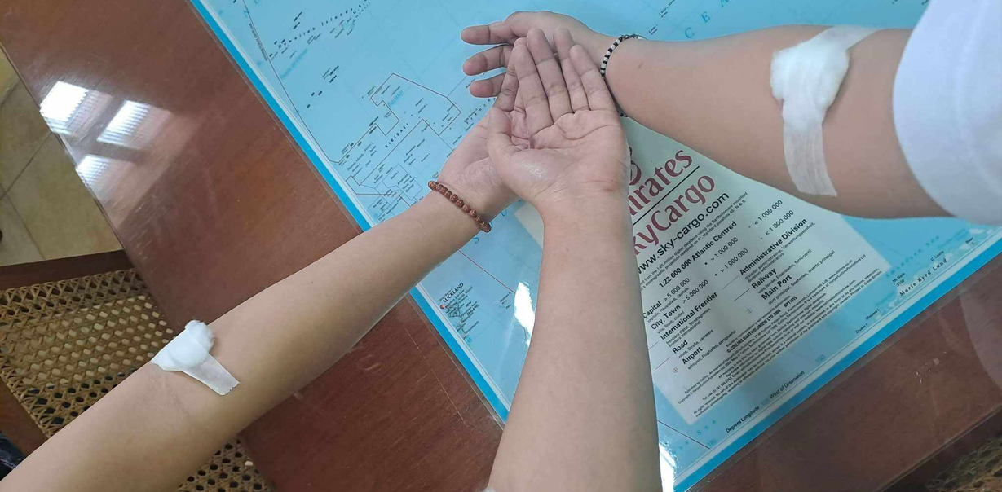
CARE AT WORK PROJECT
On June 8, 2024, the Care at Work: Health Made Easy initiative was launched. The project is designed to be an annual event to support the health and well-being of the workforce.

Slide 20
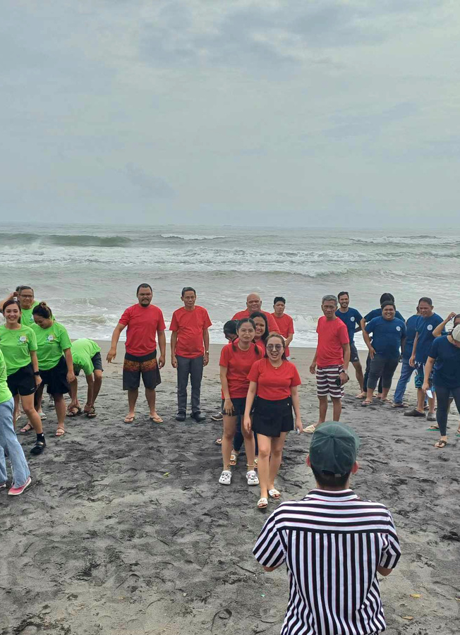
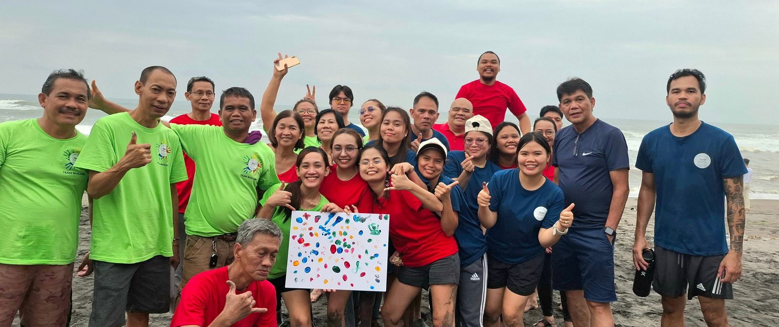
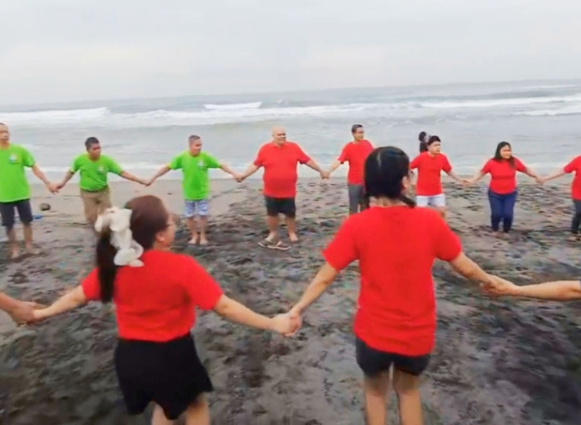
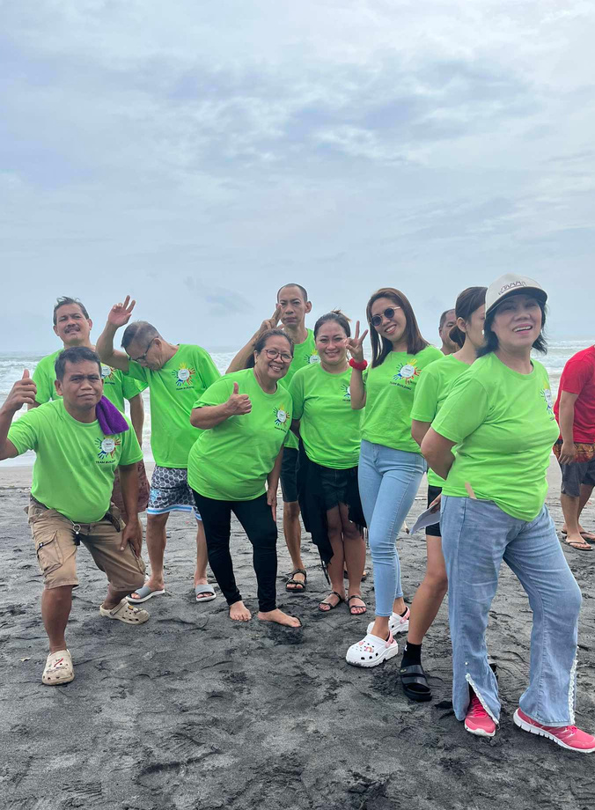
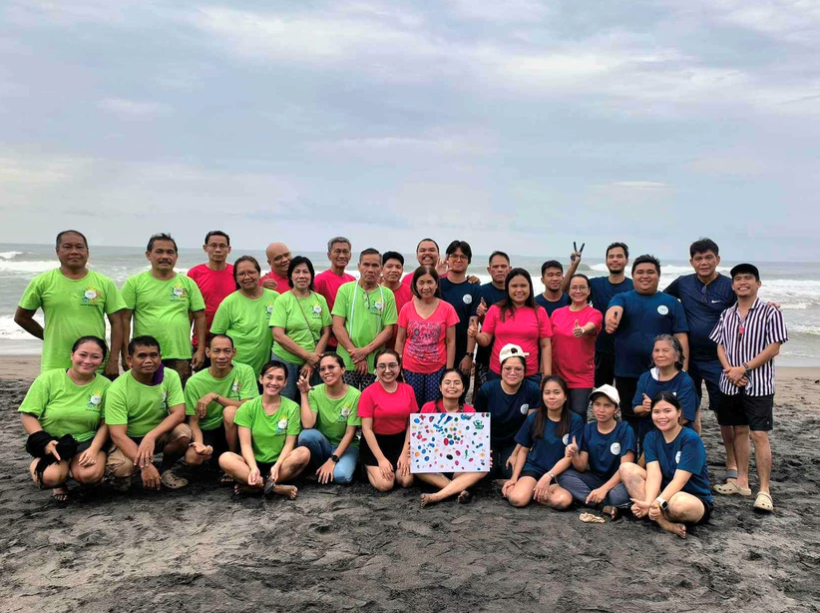
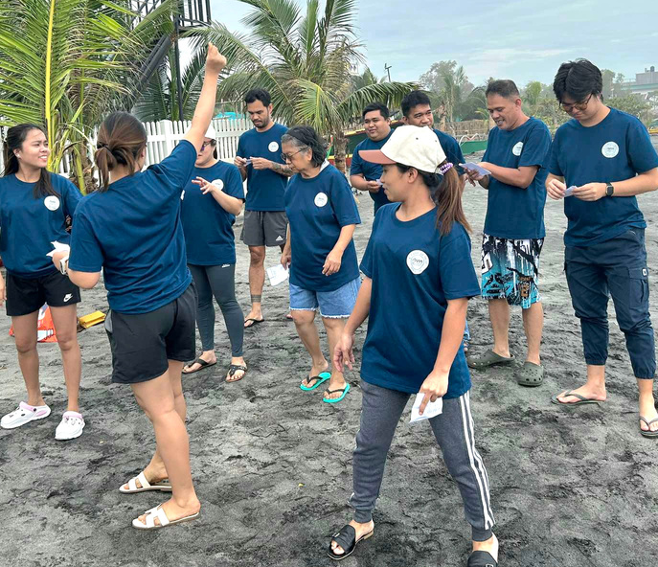
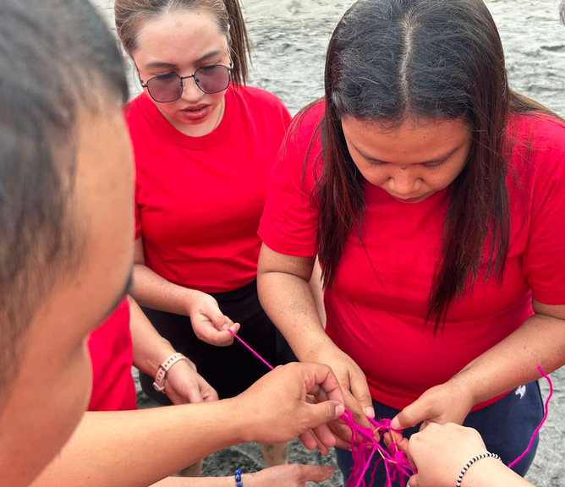
TEAM BUILDING 2024

Slide 21
STAMM INTERNATIONAL, INC.
ENVIRONMENT UPDATES
12 April, 2025

Slide 22
SUSTAINABILITY ON ENVIRONMENT REPORT
STAMM INTERNATIONAL, INC.
01
GREENING THE WORKPLACE
02
GLOBAL BEACH CLEAN UP
03
TREE PLANTING
04
TREE PLANTING WITH PMTLAI
05
INTERNATIONAL COASTAL CLEANUP

Slide 23
GREENING THE WORKPLACE

Slide 24
GLOBAL BEACH CLEAN UP

Slide 25
TREE PLANTING ACTIVTY WITH PMTLAI

Slide 26
TREE PLANTING

Slide 27
INTERNATIONAL COASTAL
CLEAN UP

Slide 28
STAMM SUSTAINABILITY AGENDA 2025
JANUARY
FEBRUARY
MARCH
APRIL
MAY
Bloodletting Activity with PMTLAI
Annual Check-up
Women’s Month Celebration
Beach Clean-up
installation of solar panels
Step up challenge (Q2)
Mangrove Planting
Earth day
Step-up Challenge (Q1)
Feeding program
Mother’s Day Celebration
JUNE
JULY
AUGUST
SEPTEMBER
OCTOBER
Father’s Day Celebration
Tree Planting
Step-up Challenge (Q3)
Workplace clean-up
International Coastal Clean-up
Mental Health Awareness seminar
Step-up Challenge (Q4)

Slide 29
THANK YOU

